Slide 1


Predictive Modelling for Loan Approval
The aim of this project is to develop a predictive model that will help determine the eligibility of loan applicants based on various criteria such as income, employment status, and credit history. By automating the loan approval process, this model will enhance efficiency, accuracy, and compliance with financial regulations.
Bhavna Balakrishnan
33954437

Slide 2
Benefits and Value Creation
Efficiency and Accuracy
Cost Reduction
The predictive model reduces manual processing time and errors, leading to faster and more accurate loan decisions.
Automating processes typically results in significant cost savings in terms of human labour and the associated expenses of manual errors and delays.
Risk Mitigation
Improved Customer Experience
The model helps in identifying potential defaulters early in the loan application process, thereby reducing the likelihood of bad debt and improving the overall credit risk profile of the portfolio.
Customers benefit from quicker loan processing times and a more transparent assessment process, which can improve their overall satisfaction and trust in the financial institution.

Slide 3

Stakeholder Benefits
1
Financial Institutions
2
Customers
3
Regulators
Loan applicants receive faster responses and fair treatment due to the unbiased nature of the automated decision-making process.
Regulatory bodies can rely on the use of such models to ensure that financial institutions are complying with guidelines and managing risks appropriately.
Banks, credit unions, and other lenders can streamline their loan processing workflows, enhance customer satisfaction, and ensure compliance with regulatory standards.

Slide 4
Challenges
Data Quality and Availability
Model Bias and Fairness
High-quality, accurate, and comprehensive data is crucial for building effective predictive models. The availability and integrity of data can be a significant hurdle.
Ensuring the model does not perpetuate existing biases and discriminates against certain groups of people is a critical challenge. The model must be regularly audited for fairness.
Scalability and Reliability
Regulatory Compliance
The model must be scalable to handle large volumes of applications and reliable enough to maintain performance over time without frequent downtimes or errors.
Navigating the complex landscape of financial regulations and ensuring the model complies with all relevant laws and guidelines is an ongoing challenge.

Slide 5

Data Sources
1
Financial Records
Data from bank statements, credit card histories, and previous loan records which can provide insights into the financial behaviour of applicants.
2
Employment Information
Details about employment status, duration, and income level from databases maintained by employers or collected directly from applicants.
3
Credit Bureaus
Comprehensive reports from credit bureaus that include credit scores, existing debts, and credit history.

Slide 6




Data Characteristics
Volume
Velocity
Variety
Veracity
For such a project, the volume would be tremendous in realistic scenarios. For the purpose of this assignment, the dataset has about 4,300 rows.
Data flow will be continuous as new applications come in and additional data (like credit scores) updates regularly.
Data will include a mix of structured data (e.g., income levels, credit scores) and unstructured data (e.g., employment history narratives).
The accuracy and truthfulness of the data can vary, particularly with self-reported data, requiring verification processes.

Slide 8
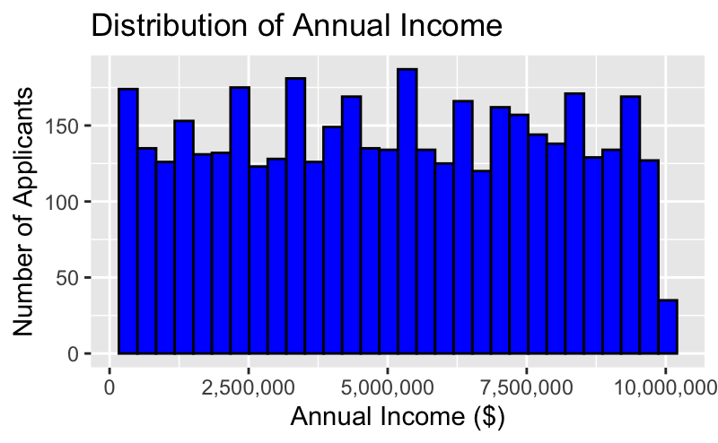
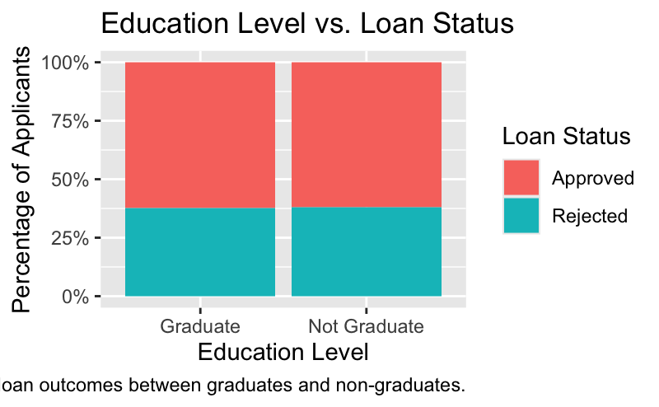
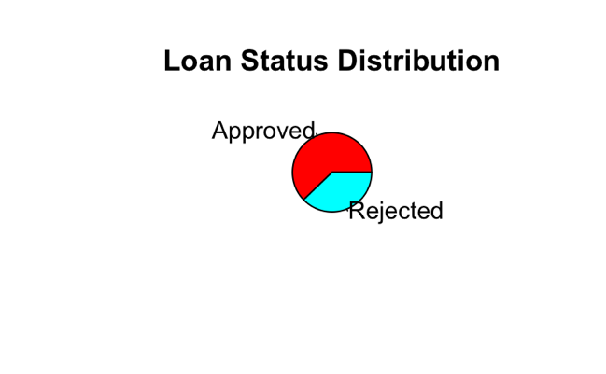
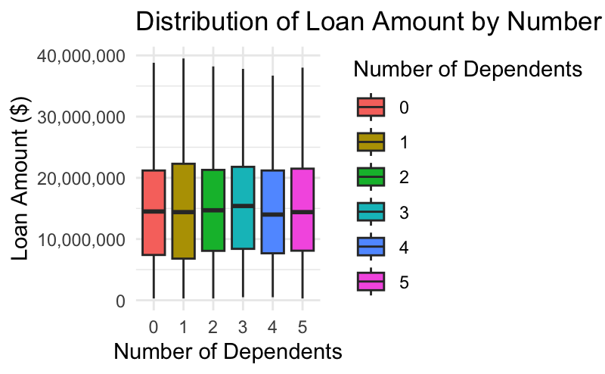
Insights

Slide 9
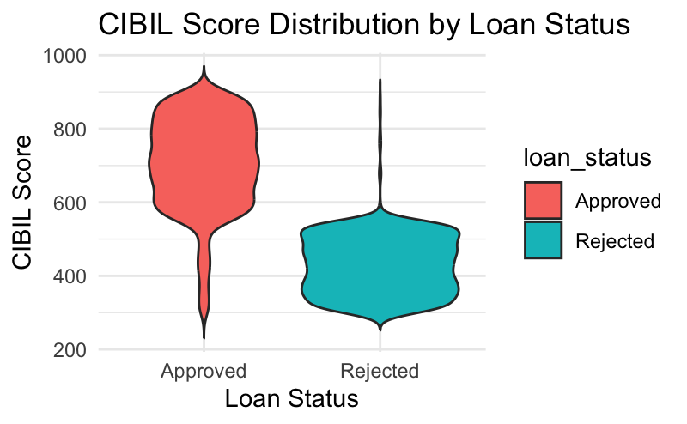
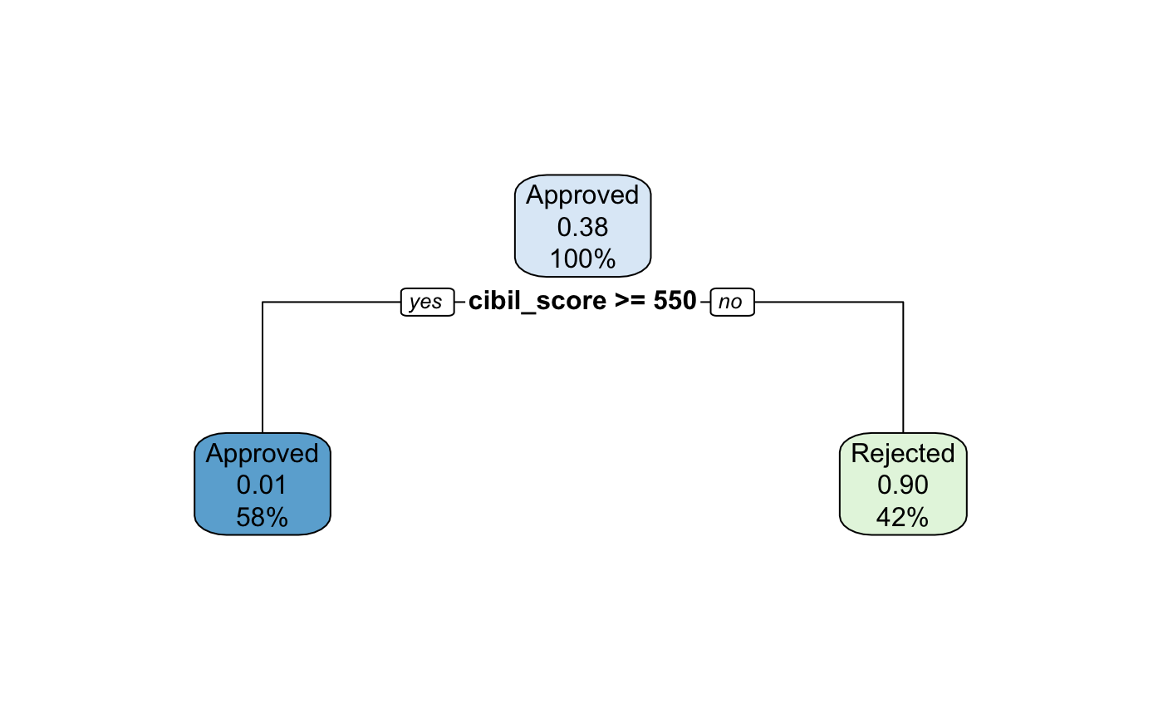
Insights

Slide 10
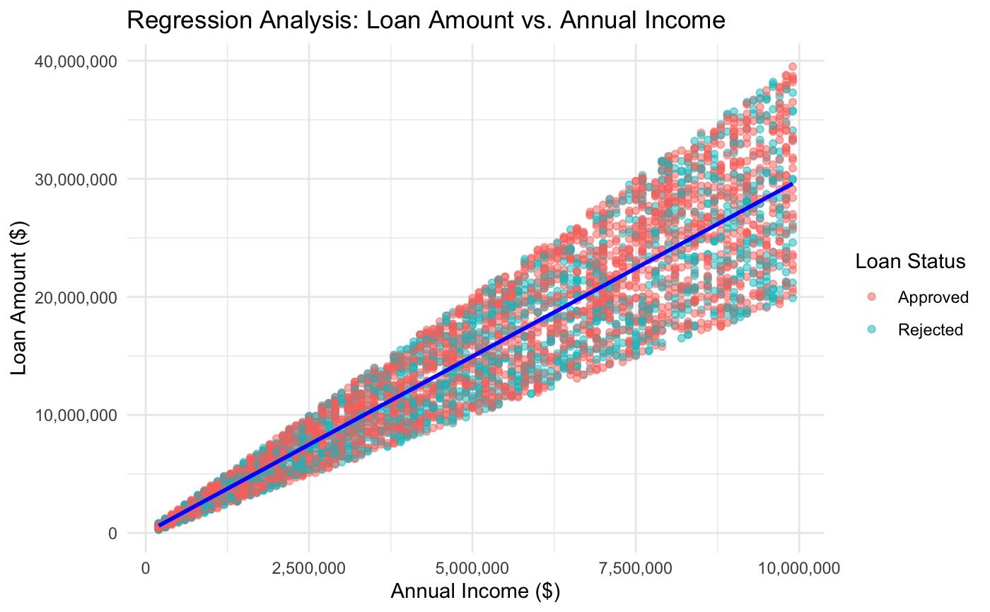
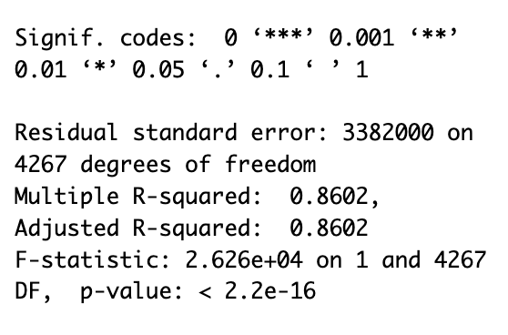
Insights

